Slide 1
Microservices - Why?
Or why not?
Speaker: Sascha Düpre
LinkedIn: https://www.linkedin.com/in/sascha-duepre/
Twitter: @sascha10000
GitHub: @sascha10000

Slide 2
Agenda
Microservice and Monolith Architectural Style
Brief introductions
Comparison
Microservices
Project management view
Team/Microservice size
Roles
Process model assumptions
Conclusion
Part 2?
Use Case and some technical things
2/20

Slide 3
What are microservices?
“In short, the microservice architectural style [1] is an approach to developing a single application as a suite of small services, each running in its own process and communicating with lightweight mechanisms, often an HTTP resource API.” - Martin Fowler
Many “small” services (business logic is split up)
Independent and automatically deployable
Lightweight Communication
3/20

Slide 4
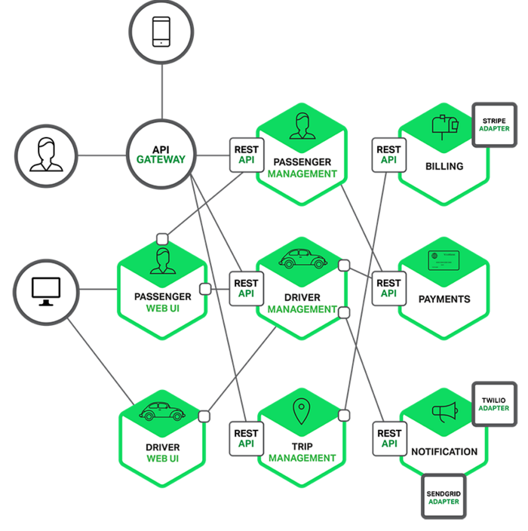
Source: https://www.nginx.com/blog/introduction-to-microservices/
4/20

Slide 5
What is a monolith?
Traditionally split into 3 parts (3-Tier-Architecture)
UI (Client), AS (Business logic), DB (Data)
AS is the core (should be modularized)
Gets Requests
Handles business logic
Makes DB transactions/calls
Populates HTML-Views
Deployed as a single executable
5/20

Slide 6
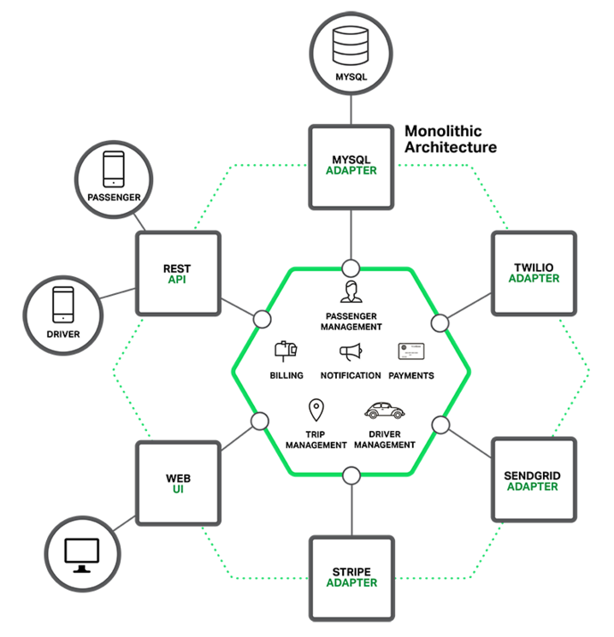
Source: https://www.nginx.com/blog/introduction-to-microservices/
6/20

Slide 7


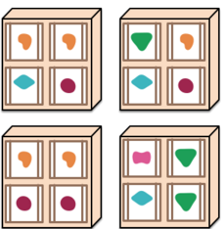
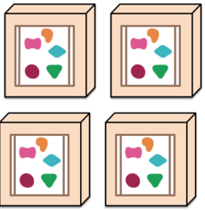
What about scaling?
Monolith Microservices
Scale-Up
Scale-Out
7/20
Source: http://martinfowler.com/articles/microservices.html

Slide 8
Some Ups and Downs -- Monolith
Short time-to-market
Cross-Cutting-Concerns (e.g. Logging) can be handled centralized (via libs)
Strong dependencies
Scaling: Deployment of the whole Application to another environment (e.g. VM)
8/20

Slide 9
Some Ups and Downs -- Microservice
No dependencies to other services
Scaling: Each service can be deployed separate
Operational overhead
Longer time-to-market
9/20

Slide 10
Where to start?
Under the assumption this is a pioneer project with “enough” resources….
How big should a team be? And therefore, the Microservice?
Which roles exist in a team? (This is a general topic)
[More explicit] What personnel is needed?
What process model should be used?
What are the requirements?
How many services/teams do we need?
10/20
Notes:
First two questions are more general.
And the last ones will answered with regard to the use case.

Slide 11
Team size (1/2)
Group question: Of what sizes are you thinking for each team per service? And maybe why?
Some responsibilities (while the product is not live)
Testing
UI
Logic
DB(s)
Middleware
Operations
11/20

Slide 12
Team size (2/2)
Less than 10 as a rule of thumb. Amazon says 6-8 -- Two-Pizza-Rule
Should be small enough to decrease the complexity of communication
Big enough to build and run the product
All competences must be covered
Conway’s law: The size will determine the structure and LOC of the service
12/20

Slide 13
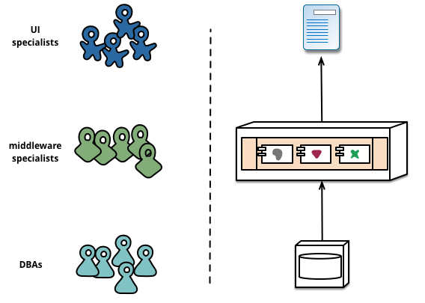
Which roles exist in a team? (1/2)
Conway’s law:
“Organizations which design systems […] are constrained to produce designs which are copies of the communication structures of these organizations.” - Melvin E. Conway
Driven by the management because they see the technology stack
Source: http://martinfowler.com/articles/microservices.html
13/20

Slide 14
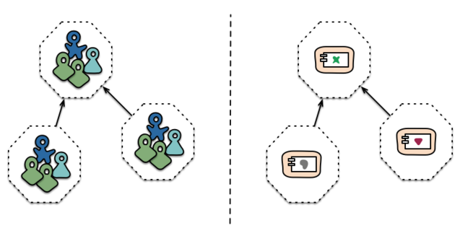
Which roles exist in a team? (2/2)
Cross-functional teams
Organized around business capabilities
Responsibility to build and operate each product
=> Team organizes itself and is product and data owner
Source: http://martinfowler.com/articles/microservices.html
14/20

Slide 15
Team roles - Conclusion
Operators are needed
Developers are needed
Consider DevOps
General Problem: From the moment the product runs in production you will need to have a team member for emergency cases available.
“I work from 9-5; no interest in working more besides overtime.” - Random Employee
“I love my work. I like to work more if it’s interesting.” - Another Random Employee
People don’t want to work on attendance (“9-5”, “Not interesting”)
In the US: One may get fired if they won’t do it.
In Germany: It’s on free will; one needs a “fair” model or have an explicit operator.
Solution : DevOps (expensive)
What do you think is a central problem, that these roles share?
15/20
Notes:
Consider a problem in the production. Now the operator will try his best, but if it will fail over and over again because of a software lack, he won’t be able to find a solution -- he will need a dev.

Slide 16
Considerations for the process model
Agile development (it’s a methodology)
Iterative (work a while then review and again)
Streamlined (getting to work)
Time-boxed (you work in time boxes)
Very collaborative (you are talking to your team and other teams all time)
Test-driven-design
Domain-driven-design
SCRUM (as a concrete process model)
Extreme-programming
…
16/20
Notes:
Iterative: Instead of planning everything front up and then implementing one will plan and then implement some features and maybe replan e.g..
Streamlined: Instead of long meetings. There are daily short meetings (15 mins) where everybody has a stand up. And then there is some time to talk to each other.
Time-Boxed: You say okay lets work 3 weeks and see what gets done. In SCRUM you are using a backlog which contains the requirements broken down to features. And you’ll say we try to implement features a,c,g,e and another team makes f,b,d.
Basic conclusion: This topic could fill plenty of hours. You may need to fit it according to your needs.

Slide 17
Conclusion to those “management” questions
In case of a pioneer project ….
Lack of experiences with microservices => High Risk Level
Wrong interpretation of the whole
Operations will overwhelm you
Longer time-to-market if not even failure
With experience => Low Risk Level
Short delivery cycles (agile dev)
Extremely modular / Independent development & deployment
Still longer time-to-market than with monolith (in general)
If you don’t have experience buy it! External Devs and/or Ops.
17/20

Slide 18
Microservices Why?
Modularity, independent development and operations
Scaling can be done per service
Technology diversity -- Polyglott presence
Right technology stack for the problem (languages, libraries, middleware, databases)
Exchangeable
You can replace a service with “no effort” regarding to a monolith architecture
Effective and not more communication
Devs see the consequences of their actions
18/20

Slide 19
Microservices Why not?
Lack of needed experience
Not enough resources to buy it
Long(er) time-to-market
(Highly) distributed system
Therefore: Eventual consistency
System and Operational complexity
Cross service testing is hard
Network and resource overhead
Security
19/20

Slide 20
And now?
If you consider using a microservice approach
Do we have the capabilities (resources)?
Do we have organizational complexity?
Do we need the scaling abilities?
Do we need to deliver software faster and maybe deliver regular updates?
As one can see these points are project dependent. Therefore you may not say: “Let’s make everything as a MS.”. One need to reconsider it all the time!
20/20

Slide 21
Want to dive deeper?
We got a project management view on that topic? Yes! We can answer the central question? Yes!
Whats missing?
Use-Case - Technical details
With concrete services
Overview of cross-cutting-concerns
Let’s get rid of the abstraction in the previous part!
Profit: You will see more of the whole microservice thing!
Yes!
No!

Slide 22
Who is living microservices? (1/4)
Walmart
Bought OneOps and worked 2 years on a DevOps API
OpenSource (oneops.com)
“Four years ago, the Walmart Global eCommerce system was a monolithic application, deployed once every 2 months.” - walmart.com [2016]
“On a typical day there are now over 1,000 deployments, executed on-demand by development teams, each taking only minutes on average to complete.”

Slide 23
Who is living microservices? (2/4)
Netflix
They obviously need microservices
Contribute to the OpenSource community (only some well-known)
Hystrix
Chaos Monkey
https://github.com/Netflix/ & https://netflix.github.io/

Slide 24
Who is living microservices? (3/4)
Twitter
http://twitter.github.io/
Finagle
Own MySQL fork
History
Started with a three-tier ruby on rails architecture
Switched to a more Services oriented approach
Developed to microservices
Now have several services in different languages (Ruby for front end [2016])

Slide 25
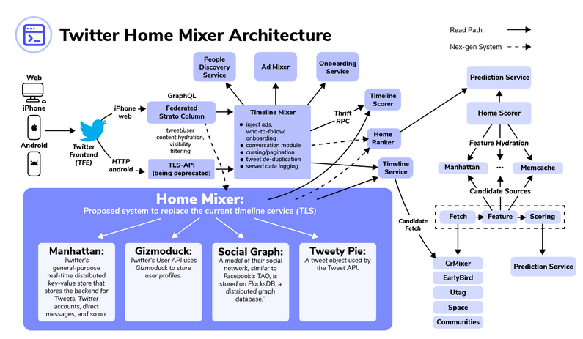
Who is living microservices? (3/4)
Source: https://www.educative.io/blog/twitter-design#current

Slide 26
Who is living microservices? (4/4)
Many more
Amazon
Ebay
Google
PayPal
Soundcloud
In common: Evolved from monolith architectural style

Slide 27
Use-case -- Shopsystem
Common scenario: An user chooses one or many articles from an article list to buy.
Objects: User, Article
Actions: choose, buy
Concrete scenarios: User chooses Article(s); User buys Article(s)
ArticleManagement Service
UserManagement Service
Notes:
Before Iam showing the use case, I must mention that this process is just for conceptional reasons. You might use your own techniques for Requirements Engineering.

Slide 28
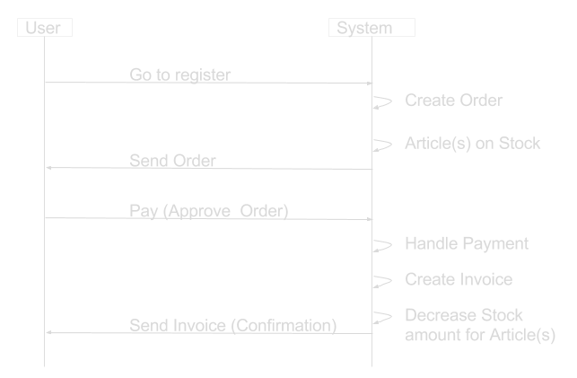
Use-case -- Shopsystem
Exemplary “Buy” scenario: User buys Article

Slide 29
Possible services -- Shopsystem
UserManagement Service
ArticleManagement Service
Recommendation Service
OrderManagement Service
ShippingService
StockManagement Service
Payment Service

Slide 30

Routing or Service-Discovery (1/3)
Microservice infrastructure handles running service instances
=> Arbitrary amount of instances per service with individual IPs
How does the client know where to route the request?
Server-Side Service Discovery
Client-Side Service-Discovery
“Kubernetes is an open-source system for automating deployment, operations, and scaling of containerized applications” - kubernetes.com

Slide 31
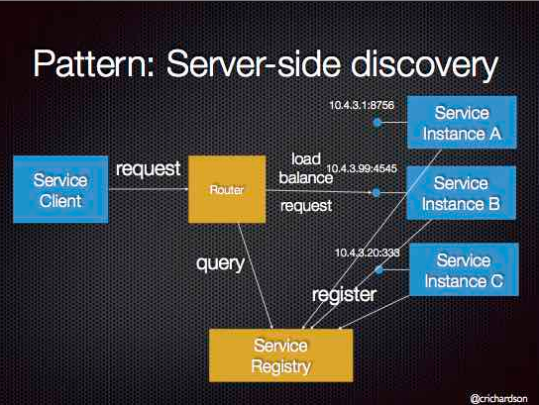

Routing or Service-Discovery (2/3)
AWS Elastic Load Balancer
Source: http://microservices.io/

Slide 32

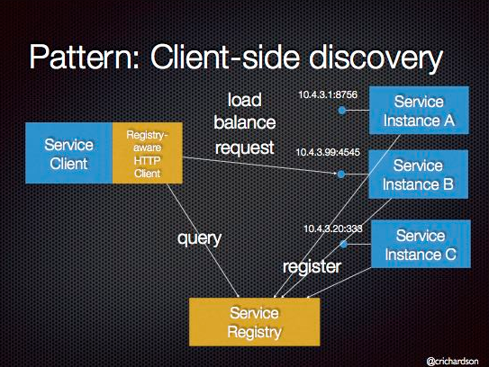
Routing or Service-Discovery (3/3)
Eureka - Service Registry
Ribbon client - REST Client querying Eureka
Source: http://microservices.io/

Slide 33
Communication between services (1/2)
ArticleManagement Service
Order Service will provide the Order
Article info
Stock amnt
Addresses
Invoice
OrderManagement Service
UserManagement Service
User (Frontend)
StockManagement Service
Payment Service

Slide 34

Communication between services (2/2)
Stateless communication e.g. HTTP
REST
SOAP (XML-RPC)
Message Service/Pipes (Java: JMS)
etc.
*
*“I implement Enterprise Integration Patters, ROAARR”

Slide 35
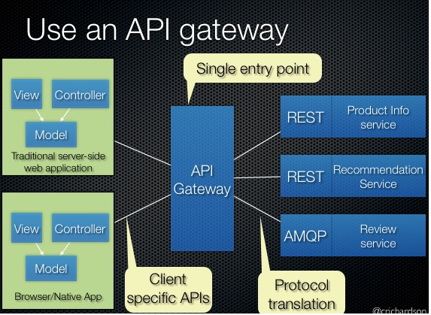
API Gateway Pattern
Hides the internal API
Provides different APIs per Client-Type (mobile, web…)
Makes version changes easier in production
Less communication overhead
Handles Service-Discovery
Source: http://microservices.io/

Slide 36
Unavailable services
Services should be deployable and runnable on it’s own
If ArticleService is down OrderService will be in serious troubles
OrderService must respond even if ArticleService is down
Fault tolerance
Cross-cutting concern
Solution: Respond with the correct HTTP StatusCode or send an uncomplete Order*
*don’t do that, it’s not responsive

Slide 37
Microservice Requirements (1/2)
Small footprint
Responsive
Rapid and consistent response times
Resilient
Fault tolerant → Let it fail!
replication, containment, isolation and delegation
Elastic
System stays responsive regardless to its workload
Message-Driven
Non-Blocking
Asynchronous
Going Reactive!
http://www.reactivemanifesto.org/

Slide 38





Microservice Requirements (2/2) – 2016
Web-Frameworks/Toolkits
Vertx.io
Java, Javascript, Groovy, Ruby, Ceylon
Play Framework
Java, Scala
WildFly
Java (JEE 7 Compliant)
(REST)-Frameworks
Finagle (Twitter)
Spray.io / Akka.io
Express JS (NodeJS)

Slide 39




Microservice Requirements (2/2) – 2024
Web-Frameworks/Toolkits
Django (Python)
Spring Boot (Java, Scala, Groovy, Kotlin)
Laravel (PHP)
Rails (Ruby)
Node (Javascript, Typescript)

Slide 40
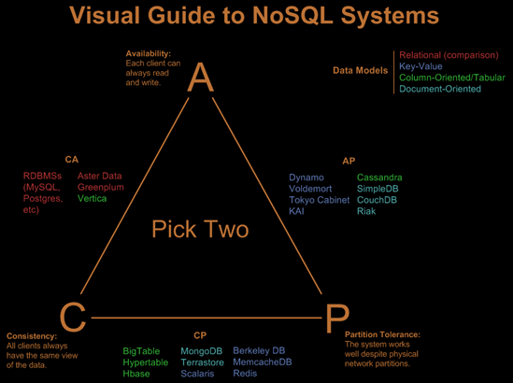
Databases
One Database for each service
Database may run on n nodes
One Database for each service instance
Additional problems are awaiting (Consistency, Routing…)
Short NoSQL Excursion
CAP-Theorem
Availability, Consistence, Partition Tolerance
Take two!

Slide 41
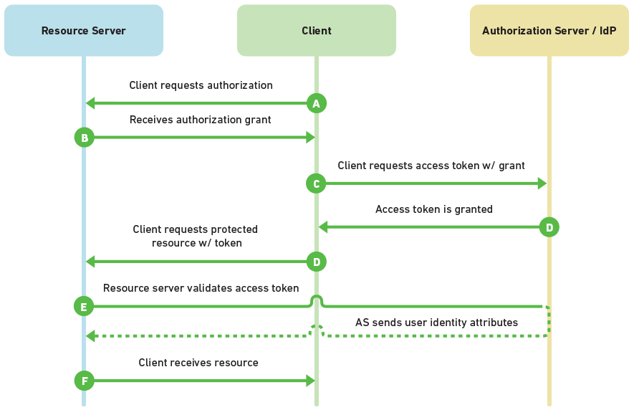
Authentication
Problem: Which Requests may the User make?
Services don’t know about the User’s permissions
Example OAuth2

Slide 42
Sources
http://martinfowler.com/articles/microservices.html
https://www.nginx.com/blog/introduction-to-microservices/
http://microservices.io/patterns/monolithic.html
http://microservices.io/patterns/microservices.html
http://microservices.io/patterns/microservice-chassis.html
http://thenewstack.io/agile-management-how-to-manage-microservices-with-your-team/
http://www.baselinemag.com/enterprise-apps/walmart-embraces-microservices-to-get-more-agile.html
http://techblog.netflix.com/
http://www.artima.com/scalazine/articles/twitter_on_scala.html

Slide 43
Microservices - Why?
Questions?
Feel free to ask!
Or why not?
Speaker: Sascha Düpre
Notes:
Thank you for listening. Special thanks to the organizators especially Randy who invited me to have a talk. Thanks.

